Slide 1




FINANCIAL INSIGHTS
OF using Power BI
Interactive Banking Analytics Dashboard
B.Tech in Computer Science & Engineering
Name-SOUNAK DEY
Power BI Data Analytics Project | Academic Year 2026
IAnudip Foundation

Slide 2
Project overview
A decision-support layer for customer, account and transaction analytics
This project combines customer account details with banking transactions to make financial patterns visible, comparable and actionable.
Raw banking data
→
Data cleaning
→
Data transformation
→
Data modeling
→
DAX measures
→
Power BI visuals
→
Insights
Two source datasets: Customer Account Details and Banking Transactions
Why banking analytics matters
Interactive dashboard for exploratory analysis and viva demonstration
Turns operational records into a shared business view
Focus areas: balances, credit scores, income proxies, activity and branch codes
Supports customer segmentation and risk monitoring
Reduces time spent on manual reporting
Financial Insights in Banking Data using Power BI | SOUNAK DEY
02

Slide 3
Problem statement
From fragmented records to an explainable banking intelligence workflow
Business challenge
Power BI response
High-volume customer and transaction records are difficult to interpret in raw form
Connect account and transaction perspectives
Important patterns may remain hidden across separate tables
Apply cleaning and standardized business logic
Traditional reporting is slow to refresh and difficult to filter
Expose KPIs, filters and comparative visuals
Decision-makers need consistent, visual evidence rather than isolated spreadsheets
Create a reusable narrative for academic demonstration
The outcome is not only a dashboard; it is a repeatable analytical method.
Financial Insights in Banking Data using Power BI | SOUNAK DEY
03

Slide 4
Project objectives
What the dashboard is designed to answer
01
Profile customer demographics and account types
05
Identify high-value and potentially dormant customers
02
Measure total and average account balances
06
Analyze transaction mix, amounts and activity
03
Assess credit-score distributions and risk bands
07
Compare branch-code activity without inventing geographic regions
04
Compare income/financial-value signals where available
08
Build interactive visuals and evidence-based recommendations
Financial Insights in Banking Data using Power BI | SOUNAK DEY
04

Slide 5
Dataset description
Source structures and observed coverage
Account records
Transaction records
Account fields used
Transaction fields used
800
1,000
9
8
Field group
Actual fields
Business meaning
Account identity
Account Number, Account Holder
Unique account traceability
Account profile
Account Type, Account Holder Details
Product and customer context
Financial measures
Balance, Loan Amount, Interest Rate
Value, exposure and pricing signals
Credit and time
Credit Score, Opening Date
Risk lens and account tenure
Transactions
Transaction ID, Account Number, Transaction Type, Amount
Customer activity and flow
Operations
Branch Code, Currency, Transaction Date, Transaction Time
Operational context and time analysis
Financial Insights in Banking Data using Power BI | SOUNAK DEY
05

Slide 6
Data preprocessing & cleaning
Quality checks are part of the analytical result, not a hidden step
Raw records
→
Quality checks
→
Standardization
→
Validated model
Observed quality issues
Treatment principles
48 account holders are blank
Keep source values traceable
15 interest-rate entries are non-numeric
Use explicit exclusions for invalid measures
60 transactions have blank transaction type
Preserve valid records for exploratory analysis
17 transactions use invalid/nonstandard currency values
Document assumptions before interpreting KPIs
Financial Insights in Banking Data using Power BI | SOUNAK DEY
06

Slide 7
Data model & Power BI architecture
A simple relationship structure supports consistent filtering
Customer Account Details
Banking Transactions
AccountNumber (key)
AccountNumber relationship
AccountNumber (link)
AccountType | Balance
TransactionType | Amount
CreditScore | LoanAmount
TransactionDate | Time
OpeningDate | customer detail
BranchCode | Currency
Modeling rationale
A shared account key lets the report move from customer profile to transaction activity without duplicating business logic.
Financial Insights in Banking Data using Power BI | SOUNAK DEY
07

Slide 8
DAX & calculated measures
Measures turn raw columns into reusable analytical language
Representative measure patterns
How measures support analysis
Total Customers = DISTINCTCOUNT(Accounts[AccountNumber])
Total Balance = SUM(Accounts[Balance])
Average Balance = AVERAGE(Accounts[Balance])
Average Credit Score = AVERAGE(Accounts[CreditScore])
Transaction Amount = SUM(Transactions[Amount])
KPI cards provide a stable executive snapshot
Filters recalculate measures consistently
Banding logic supports credit and balance segmentation
Explicit measure names make the viva narrative auditable
Note: formulas above are presentation-ready measure patterns aligned to the supplied fields; the PBIX remains the authoritative implementation.
Financial Insights in Banking Data using Power BI | SOUNAK DEY
08

Slide 9
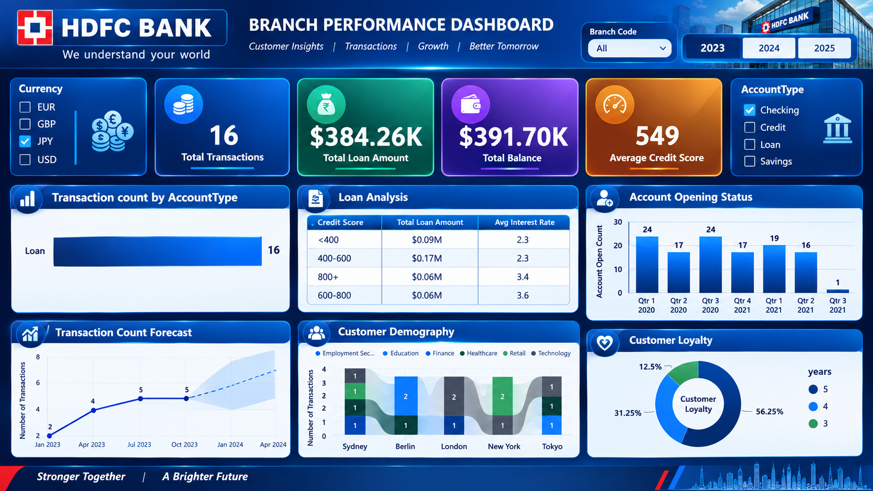
Executive dashboard
Supplied Power BI dashboard image used as the primary visual reference
Read the dashboard
Start with KPI cards
Use slicers to isolate segments
Compare balance, credit and activity views
Validate patterns against source data
Dashboard screenshot supplied with the project files.
Financial Insights in Banking Data using Power BI | SOUNAK DEY
09

Slide 10
Customer demographic analysis
The account population is distributed across sectors, cities and product types
Account type mix (800 records)
Customer context from detail fields
Savings
218
Sector
Technology
175
Loan
197
Education
169
Healthcare
160
Credit
194
Finance
152
Retail
144
Checking
191
Savings is the largest product category; the four types remain relatively balanced.
Most represented city: Tokyo (175); least represented: New York (148).
Financial Insights in Banking Data using Power BI | SOUNAK DEY
10

Slide 11
Financial & account balance analysis
Balance measures show concentration without a single dominant account type
Total balance
Average balance
Minimum balance
Maximum balance
19.28M
24.10K
7.71K
49.96K
Balance by account type
Balance bands
Savings
5566076.5M
25K–39,999
224
Credit
4686921.7M
10K–24,999
220
Loan
4594957.4M
40K+
168
Checking
4430340.5M
Below 10K
188
Financial Insights in Banking Data using Power BI | SOUNAK DEY
11

Slide 12
Credit score analysis
Credit bands provide a practical risk-monitoring lens
Average score
Minimum score
Maximum score
740+ band
574.8
300
849
165
Credit-score distribution (800 accounts)
Interpretation
Below 580
416
The below-580 band is the largest observed group (416)
165
The 740+ group contains 165 accounts and can support premium-service targeting
740+
Score bands should be combined with balance and activity before credit decisions
121
580–669
98
670–739
Financial Insights in Banking Data using Power BI | SOUNAK DEY
12

Slide 13
Income & customer value analysis
The supplied account file contains financial-value proxies rather than a dedicated income field
Available value proxies
Customer value matrix
Loan amount total
Loan amount avg.
High balance
21.36M
26.71K
High credit / lower balance
High credit / balance
Balance is available as a direct customer-value signal
Loan Amount provides an exposure/need proxy
Monitor / support
Low balance
Review exposure
Account type and credit score enable practical segments
No explicit annual-income column was found in the supplied workbook
Use the matrix as a segmentation framework; populate quadrants with interactive filters in Power BI.
Financial Insights in Banking Data using Power BI | SOUNAK DEY
13

Slide 14
Transaction & customer activity analysis
Activity metrics show a balanced mix of deposits, payments, transfers and withdrawals
Transactions
Valid amount total
Average amount
Blank type rows
1,000
4.76M
4.76K
60
Transaction count by type
Activity interpretation
Payment
247
Payments and transfers are the two largest valid transaction groups
Transfer
245
Withdrawals have the highest average amount among valid types (4.96K)
TransactionDate and TransactionTime enable future trend and seasonality analysis
Deposit
229
Invalid type/currency rows should be excluded or flagged explicitly
Withdrawal
219
Financial Insights in Banking Data using Power BI | SOUNAK DEY
14

Slide 15
Branch / operational analysis
BranchCode is available; a region or branch master is not supplied
Top branch codes by transaction count
Analytical boundary
479
8
Branch Code can support ranking tables and filters
232
7
No branch name, region, city-to-branch mapping or target KPI is present
57
7
A branch master table would unlock geography and efficiency analysis
Do not label a branch “best” without a defined denominator and target
210
6
319
6
Counts are low per code, so rankings should be treated as operational signals rather than branch-performance proof.
This is an example of responsible analytics: report what the data supports, and flag what it does not.
Financial Insights in Banking Data using Power BI | SOUNAK DEY
15

Slide 16
Customer segmentation
Segments combine value, risk and activity dimensions
High-value
Credit-strength
Monitor
High balance and/or high loan exposure
Credit score 740+
Credit score below 580
Prioritize retention and relationship management
Consider premium products with responsible risk controls
Review affordability, risk and support needs
Activity-led
Dormancy candidate
Product-led
Frequent valid transactions
Low/absent activity after validation
Savings, loan, credit or checking
Personalize engagement and cross-sell timing
Use reactivation campaigns only after confirming time window
Align product communication to account context
Segmentation is a decision framework; thresholds should be parameterized in the Power BI model rather than hard-coded in the narrative.
Financial Insights in Banking Data using Power BI | SOUNAK DEY
16

Slide 17
Key financial insights
Evidence-based observations from the supplied account and transaction files
01
800 accounts are distributed across four account types; Savings is the largest category at 218 records.
06
Technology is the most represented sector (175); Tokyo is the most represented city (175).
02
Total account balance is 19.28M, with an average of 24.10K and a 7.71K–49.96K observed range.
07
There are 1,000 transactions and 4.76M in valid transaction amount; Payment is the largest valid type by count.
03
Savings contributes the largest balance total at 5.57M, while account-type totals remain broadly comparable.
08
Data quality is material: 48 blank account holders, 15 invalid interest values and 60 blank transaction types were observed.
04
Credit scores average 574.8; 416 accounts fall below 580 and 165 are in the 740+ band.
09
Branch Code is granular and lacks a branch master, so operational rankings should not be overstated.
05
The largest balance band is 25K–39,999 with 224 accounts, closely followed by 10K–24,999 with 220.
010
The strongest decision opportunity is to combine balance, credit and activity filters into one governed view.
Financial Insights in Banking Data using Power BI | SOUNAK DEY
17

Slide 18
Recommendations & conclusion
A practical roadmap for responsible banking analytics
Recommendations
Conclusion
Parameterize value and credit segments in Power BI
The project demonstrates how Power BI can transform two operational banking datasets into an interactive analytical story. It establishes a clear model, surfaces meaningful financial patterns, and makes limitations visible so that recommendations remain credible.
Create a branch master to enable valid regional comparisons
Add an income or verified affordability field for customer value analysis
Flag invalid rows visibly and monitor data-quality KPIs
Use high-value and reactivation segments for targeted engagement
Thank You
Questions & Answers
18

